Slide 1

GESTURE RECOGNITION
FOR MOOD DETECTION
(Sponsored by HCL Infosystems Pvt.Ltd)
GUIDE: PROF. SHAMLA MANTRI

Slide 2
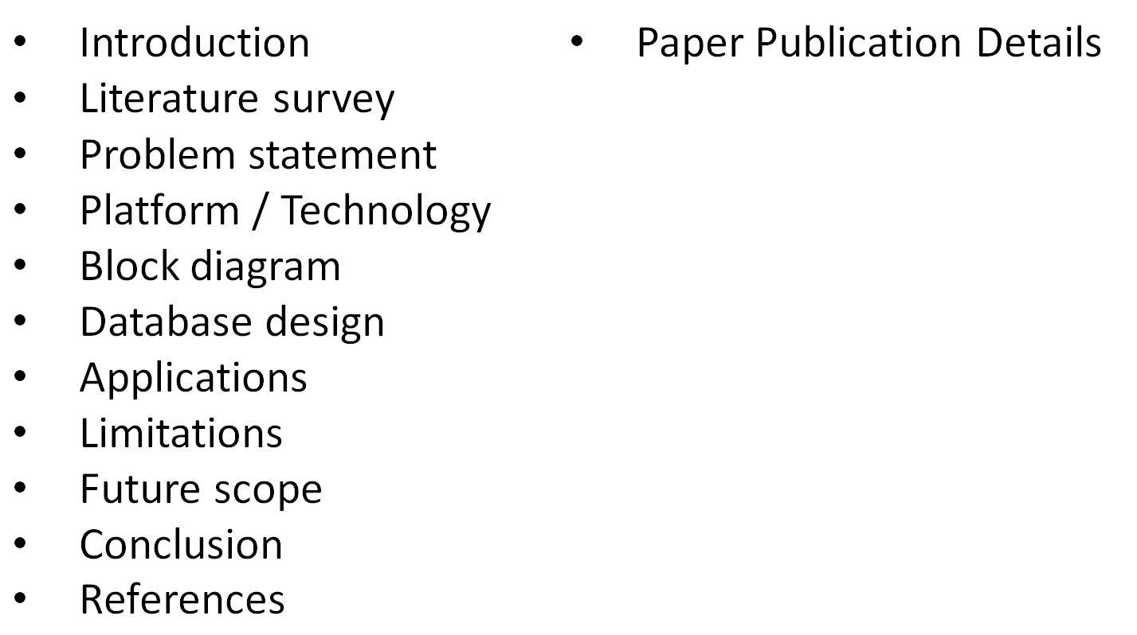
OVERVIEW

Slide 3
INTRODUCTION
A state of low mood affects a person's behavior, feelings.
Person may lose interest in pleasurable activities and may contemplate or attempt suicide.
WHO Global Burden of Disease (GBD) report by Mathers quantified unhappiness as the leading cause of disability world-wide (20% of the population).
Notes:
The global burden of disease (GBD) or Global Burden of Disease Study is a comprehensive regional and global assessment of mortality and disability from major diseases, injuries, and risk factors.

Slide 4
We are motivated to develop this system for people who are reluctant to go to practitioners and doctors in case of stressful situations and depression disorders. The system helps to detect and analyze timely depression causes and provide remedies or notify concerned doctors.
MOTIVATION

Slide 5



MOOD DISORDERS
Depressive Disorder
Cyclothymia
Recurrent Depressive Disorder
Bipolar Affective Disorder
Diagnosis becomes critical, so that treatment can be recommended.
Notes:
Cyclothymia, also called cyclothymic disorder, is a type of chronic mood disorder widely considered to be a milder or subthreshold form of bipolar disorder. Cyclothymia is characterized by numerous mood disturbances, with periods of hypomanic symptoms alternating with periods of mild or moderate depression.

Slide 6
FACIAL EXPRESSION ANALYSIS
All Facial Expression Recognition (FER) based on static, single images.
This leaves the temporal aspect of facial expressions, yet this is an important clue in correctly judging someone's facial expression.

Slide 7
LITERATURE SURVEY
Previous work done,
Analysis through image processing
Graphology- Handwriting analysis
Voice Analysis
Physiological detection/Body Movement Analysis

Slide 8
LITERATURE SURVEY
Companies currently working on it
Effectiva
Face First
Quividi
Facebanx

Slide 9
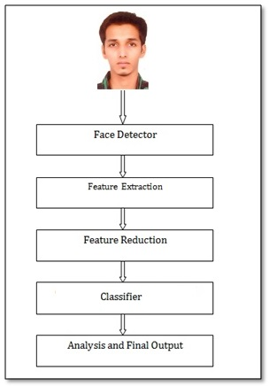
BLOCK DIAGRAM

Slide 10
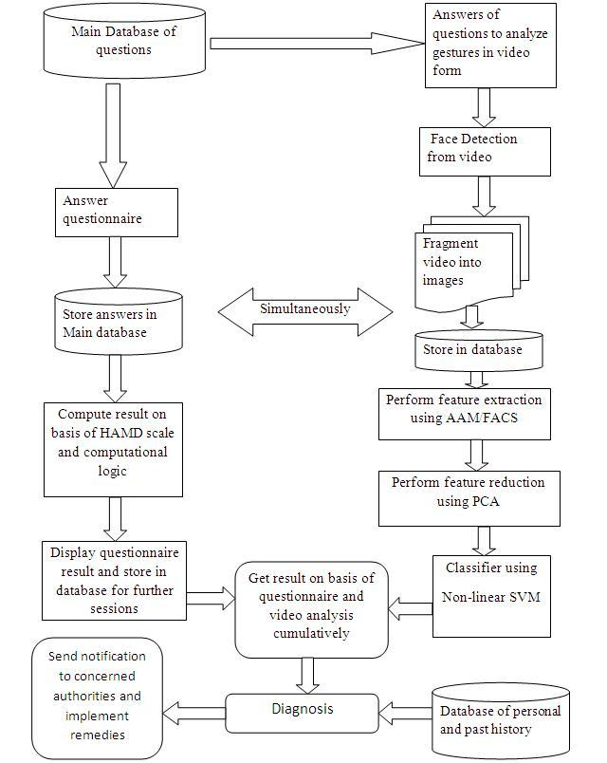

Slide 11
DATABASE DESIGN
User_Table
Primary Key (U_id)
U_id | Name | Gender | Address | Age | Contact _no | No._of_ Sessions_attended | Date | Type_ Of_ patient | User_name | Password
Admin_Table
Primary Key (Admin_id)
Foreign Key (U_id) references User_Table
Admin_id | U_id | Admin_name | Admin_profession | Address | Contact_ no

Slide 12
DATABASE DESIGN
Question_and_Answers_Table
Primary Key (Question_id)
Question_id | Question | Option(a,b,c,d) | Rating
User_Answer_Questionare_Table
Primary Key (User_answer_id)
Foreign Key(U_id) references User_Table
Foreign Key(Question_id) references Question_and_Answers_Table
User_answer_id | U_id | Question_id | Score | Session_No | Date

Slide 13
DATABASE DESIGN
Video_Path_Table
Primary Key (Video_id)
Foreign Key(U_id) references User Table
Video_id | U_id | Video_path
User_Answer_Video_Table
Primary Key (User_video_answer_id)
Foreign Key(U_id) references User Table
Foreign Key(Video_id) references Video_Path_Table
User_answer_video_id | U_id | Video_id | Score | Session_no | Date

Slide 14
DATABASE DESIGN
Images_Table
Primary Key (Image_id)
Foreign Key(U_id) references User Table
Foreign Key(Video_id) references Video_Path_Table
Image_id | U_id | Video_id | Image_path
Final_Result_Table
Primary Key (FR_id)
Foreign Key(U_id) references User Table
FR_id | U_id | Final_Result | No. of Sessions attended | Date

Slide 15
APPLICATIONS
Improving performance of employees in stressed environments.
Improving performance of students in stressed environments.
Curbing suicidal tendencies among farmers and depressed subjects.
Analyzing TRP ratings of television shows and channels.
Reducing stress of housewives.

Slide 16
LIMITATIONS
Every individual has a varied face structure.
It also varies when factors like age and gender are involved.
There exists a very thin line in between differentiating the type of gesture.
The scope is very high but it cannot be generalized for a particular gesture.

Slide 17
FUTURE SCOPE
MOOD RECOGNITION USING :-
SPEECH ANALYSIS
EEG
ECG
No Gender Dependency
We can design the software for a generalized face considering varied face structures.
Decrease the cost of the Software (camera)
Mobile application (Android)

Slide 18
FACIAL EXPRESSION
Facial expressions are dynamic and convey a lot about the state of a person
It is an important feature to compute when it comes to judging how productive an employee, a student or a person can be.
A plethora of projects are being studied and developed to analyze the feelings of a person and his/her mental state.

Slide 19
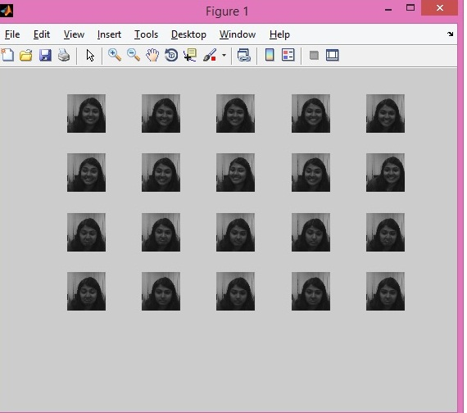
OUTPUT of FACE REDUCTION

Slide 20
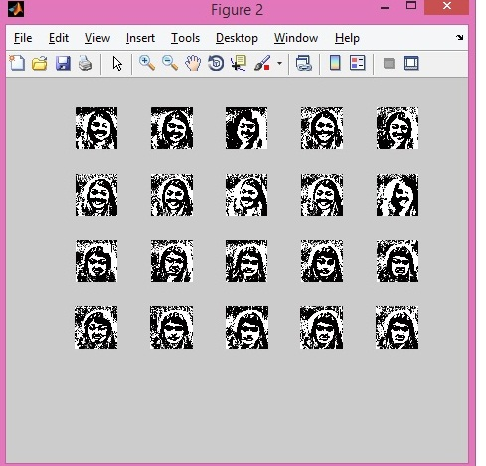
OUTPUT of FACE REDUCTION

Slide 21
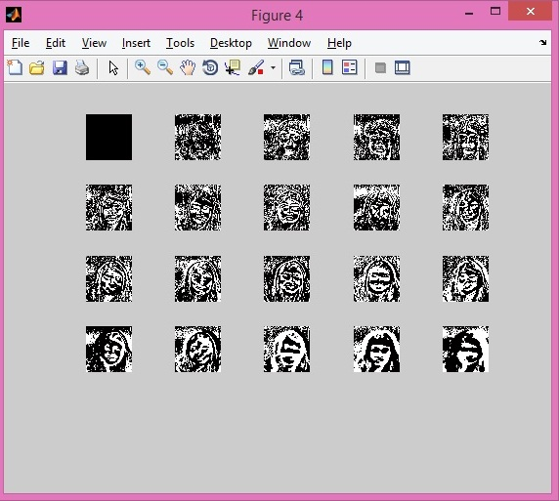
OUTPUT of FACE REDUCTION

Slide 22
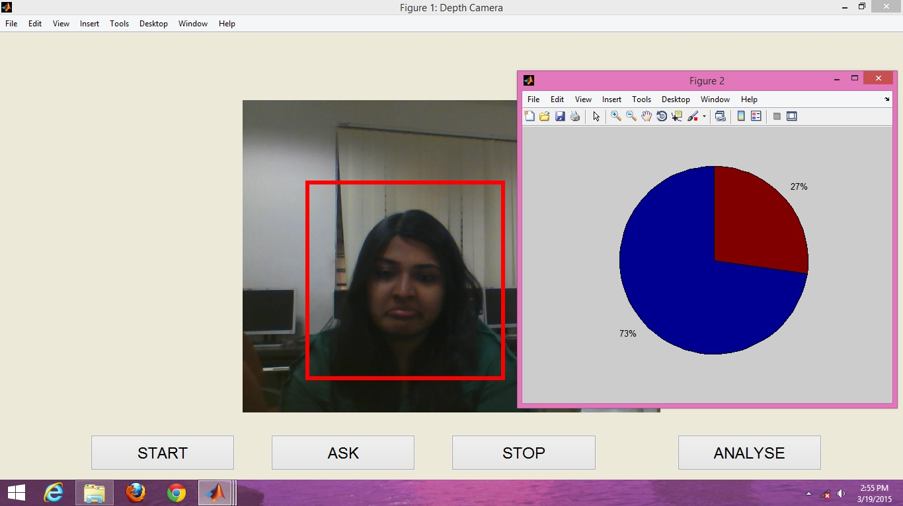
OUTPUT of FACIAL ANALYSIS

Slide 23
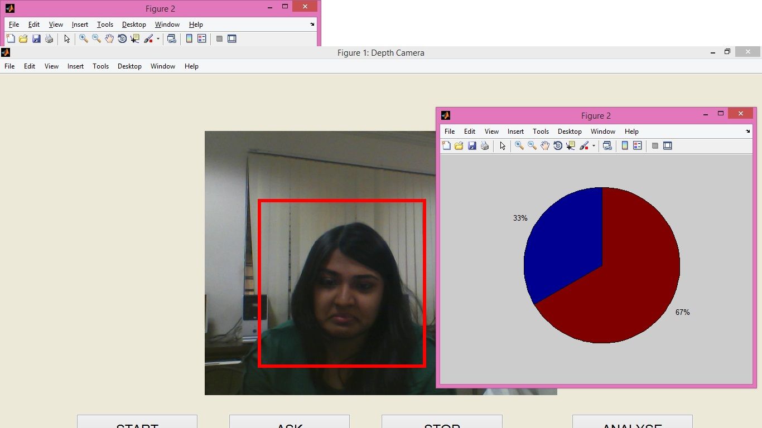
OUTPUT of FACIAL ANALYSIS

Slide 24
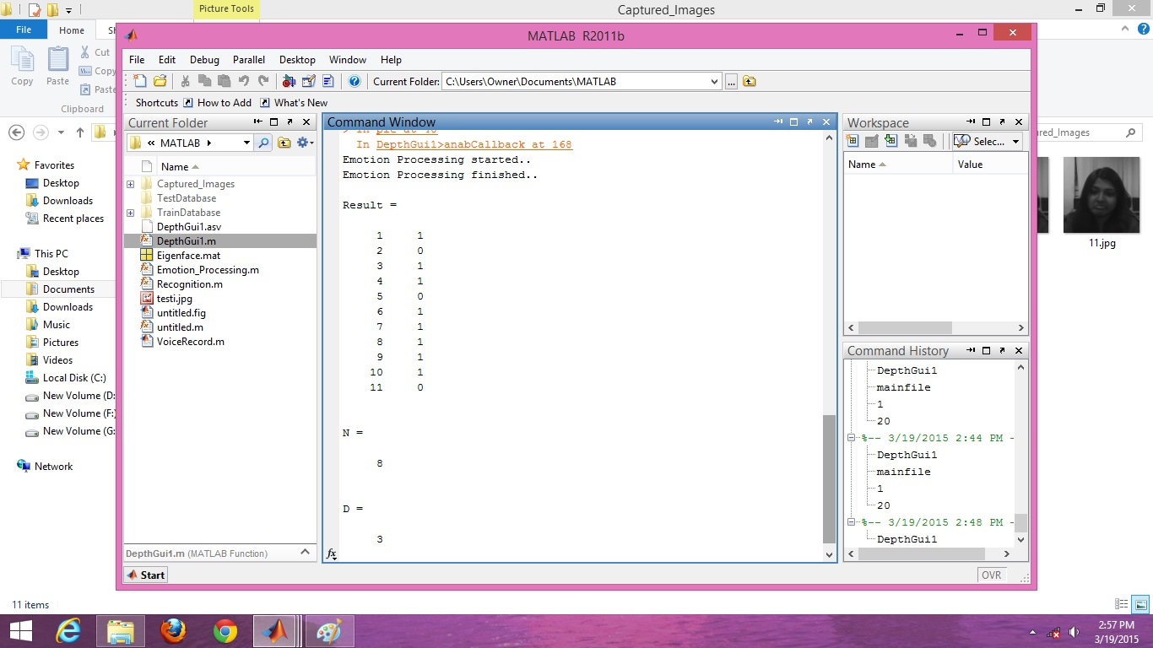
OUTPUT of FACIAL ANALYSIS

Slide 25
ALGORITHMS
Active Appearance Model (AAM)
Principal Component Analysis (PCA)
Non-Linear Support Vector Machine (SVM)

Slide 26
CONCLUSION
A framework for mood recognition was proposed.
Facial features will be extracted with the help of the algorithms mentioned.
Our research is concerned with developing affective sensing techniques, which supports psychologists in the initial diagnosis and the ongoing monitoring during treatment.

Slide 27
REFERENCES
[1] Jyoti Joshi, Roland Goecke, Gordon Parker and Michael Breakspear , “Can Body Expressions Contribute to Automatic Depression Analysis?”
[2] Jyoti Joshi “An Automated Framework for Depression Analysis” , ACII 2013: 630-635
[3] Jyoti Joshi, “Depression Analysis: A Multimodal Approach”
[4] Jeffrey F. Cohn, Tomas Simon Kruez, Iain Matthews ” , Detecting Depression from Facial Actions and Vocal Prosody”
[5] Kuan Ee Brian Ooi, Lu-Shih Alex Low, Margaret Lech and Nicholas Allen, “Prediction of clinical depression in adolescents using facial image Analysis”

Slide 28
Paper Publication Details
Name:
A Survey on the Available Algorithms for Recognizing Depression Disorders through Gesture Recognition
Journal:
International Journal of Scientific & Engineering Research
Details:
Volume 5, Issue 10, October-2014
Impact Factor : 2.9
ISSN 2229-5518
Page No. 1129

Slide 29

Project Members
Sunny Bangale
Sonal Gadiya
Sonakshi Nathak
Ramolee Chaudhari

